Slide 1
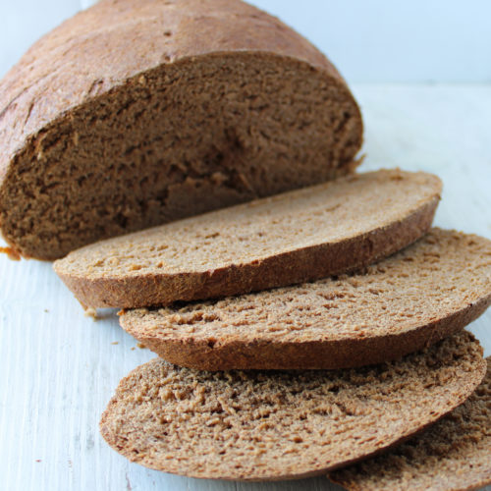
Co-products circularity in the Bakery Industry
EFFPA webinar 06-06-23
The Role of Food Manufacturers and Retailers in the Processing of Former Foodstuffs
Together in Support of a Circular Economy
AIBI Aisbl – Didier Jans

Slide 2
AIBI International Association of Plant Bakers
Large / plant bakers in EU + UK + Ukraine
Centralised/regional workshops up to multinationals
Wide product diversity (Bread – special Bread – fine bakery – pastry, finished products, bake-off, frozen, etc.)
Ca. 400 cies
> 35 Mio T Bread / bakery products
Average EU Bread consumption 56 Kg / pers/ years
Bakery is one of the largest food sector

Slide 3
Towards Zero food wastes …
The Strategy
SDG 12.3 (50% global per capita food waste) / EU Code Responsible Food Business
Operational objectives to minimize food wastes (towards zero)
The philosophy
Circulate products at their highest circularity value
The contexts
Production / operation level
Distribution (retails, Hotrec, others)
At consumer/household level

Slide 4
Management at production level Towards Zero food wastes
Causes /mitigation/remedies
Technical issues
Overproduction
Quality defects
Current picture
No public statistics available
Variable according to companies and types of operations
Current order of magnitude: 8% of bakery production
On basis of 35 Mio T = 280.000T
Reducing / re-using / diverting

Slide 5
Average fate of bakery co-products
Food stuffs of edible quality – maintain in food chain or equivalent high-grade process
Incineration < 0,1 %

Slide 6
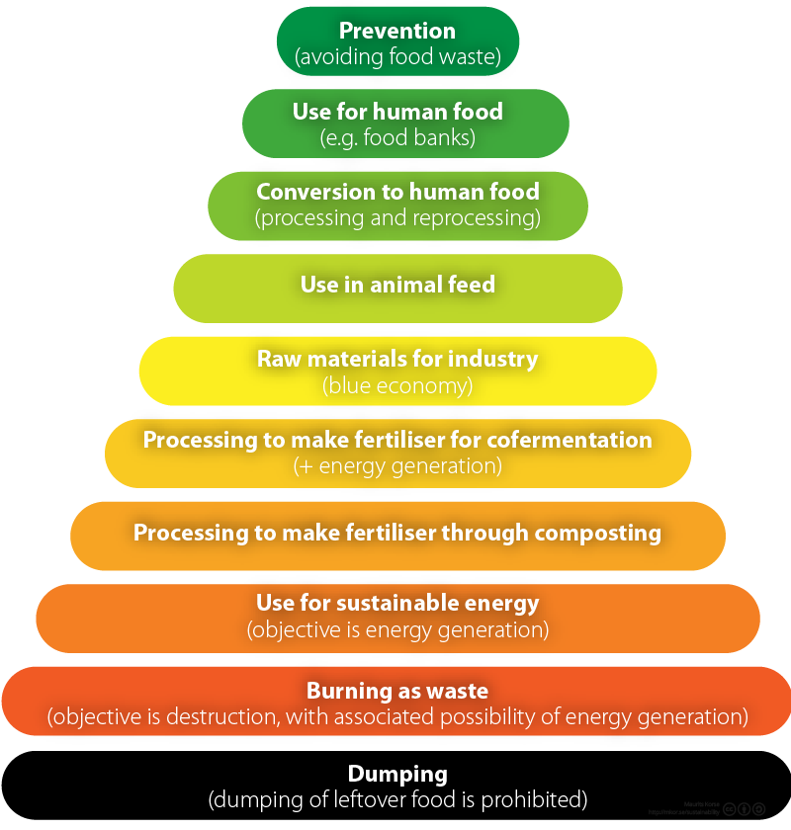
Virtuous strategy Moerman ladder
Cies Sustainability strategy
1% Time and logistics contingencies
3% Demand limitations
3% Demand limitation
75% Suitable /established path
1% In progress / R&D
20% Composite products unsuitable for feed
Practically nil < 0,1%

Slide 7
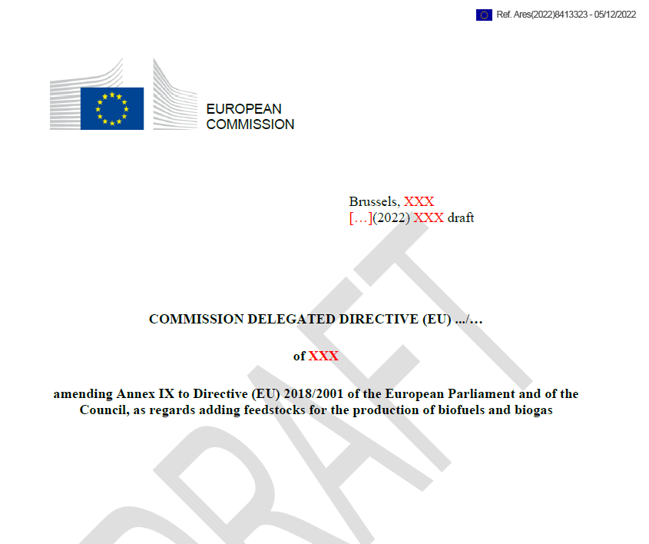
Management at production level Towards Zero food wastes
Some Regulatory interferences …
Renewable Energy Directive
Fair energy focus but stumbling on competing uses /silos competences
Food supply prominence identified / 2nd generation biofuels
Questionable assessment (volume and impacts)
AIBI asked DG Energy to withdraw bakery wastes from it’s Annex IX delegated proposal
Outcome … ?

Slide 8
Bread to feed: a well-established partnership
High nutrition value
Established logistics
Managed interface Food/Feed
Sustainability
Economic viability
Low processing
Hygiene (e.g. NVB/NBVO code)

Slide 9
Thank you for Your Attention
AIBI Aisbl
www.aibi.eu
info@aibi.eu

