Slide 1
Retail and Wholesale reducing Food Waste
Green Week Partner Event 6th June, 2023

Slide 2
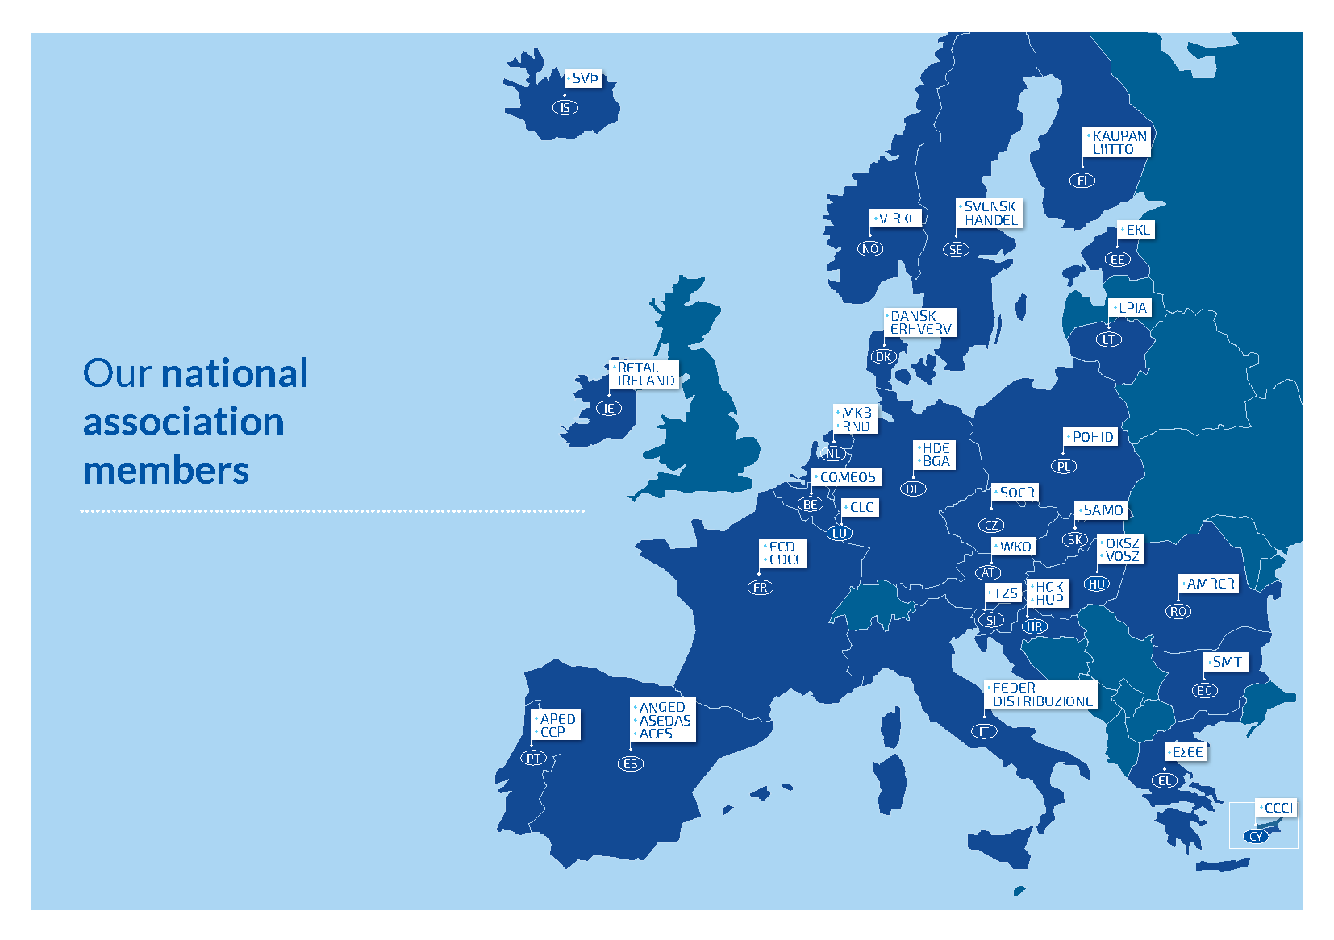
Who we are, what we do
We stand for:
Fair, competitive & sustainable retail and wholesale in Europe.
through
EU advocacy and Intelligence
Research, learnings and thought leadership
Exchange and networking
Positive communication and sector reputation
1 in 4 companies in the EU are SME retailers and wholesalers
Retail and Wholesale represents 10% of the EU’s GDP
We provide work to 26 million Europeans, so 1 in 7 of all jobs

Slide 3
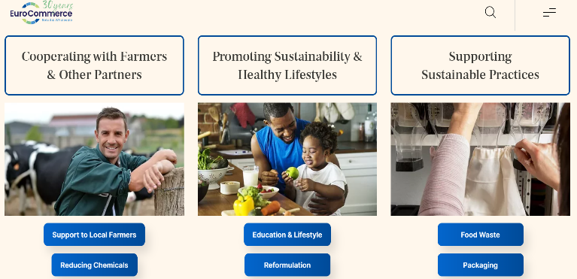
A few of many Retail & Wholesale engagements
Notes:
.

Slide 4
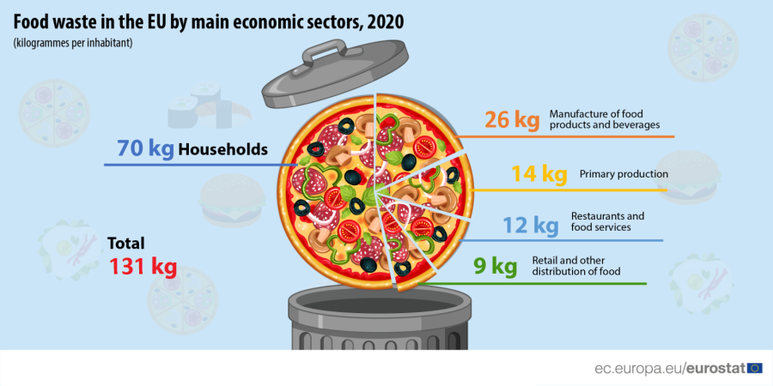
Food Waste in the European Union 2022
Retail and other distribution of food – the sector with the least amount of food waste (9 kg; 7 %)

Slide 5
Integrating the food waste hierarchy in Retail and Wholesale

Slide 6
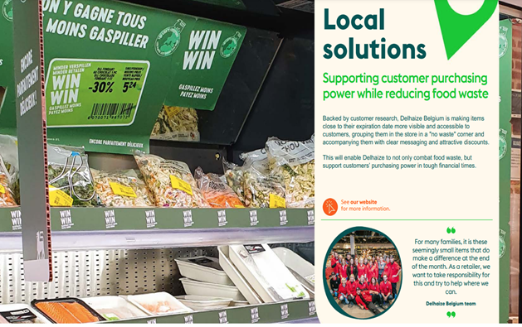
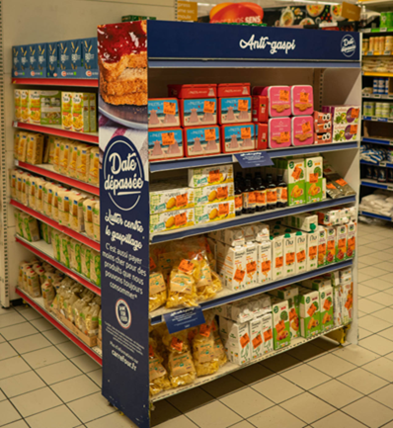
Actions to reduce Food Waste – a few examples in store

Slide 7
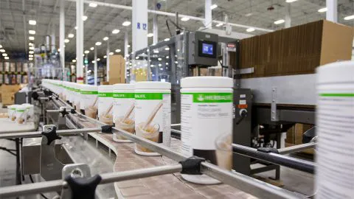
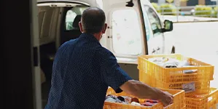
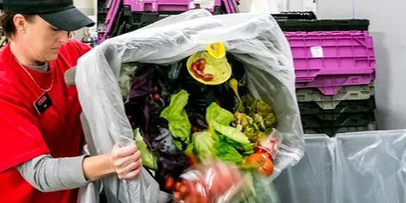
Actions to reduce Food Waste -

Slide 8
Conclusions
Retail and wholesale continue addressing food waste
Prevention always the preferred option
Retail and wholesale address food waste at different stages
Important role towards consumers
Working with start-ups allows continued innovation
More knowledge is needed on using former food products for animal feed
Address legal barriers – clarify definitions and on insect farming

