Slide 1
GMP+ International
Adding value to former foodstuffs
EFFPA #EU Green week – 06 June 2023
Jaap van der Kloet

Slide 2
Content
Introduction to GMP+ International
Understanding feed safety
What food companies can do

Slide 3

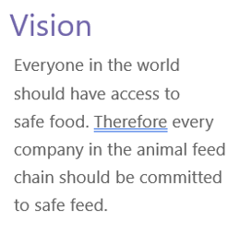

Slide 5
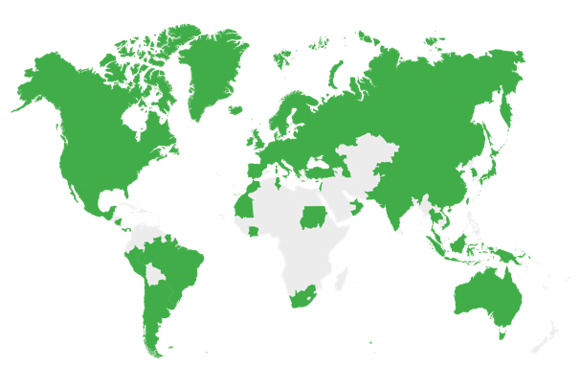
The biggest feed certification scheme in the world*
1992
Year of establishment in
the Netherlands
463
Auditors
>19,000
GMP+ FSA Certified
companies
70
Feed & Food chain
partners
89
Countries
850
GMP+ FRA Certified
companies
30
Certification Bodies
*January 2023

Slide 6



Chain approach
Cultivation
& fishing
Trade, storage
and transshipment
Transport
Processing
and production
feed ingredients
Production of
premixtures and
compound feed
Livestock
& aqua
farming
Dairy,
meat,
eggs
& aqua
proces-
sing
Retail
Gatekeeper
Quality
schemes
Quality
schemes

Slide 7
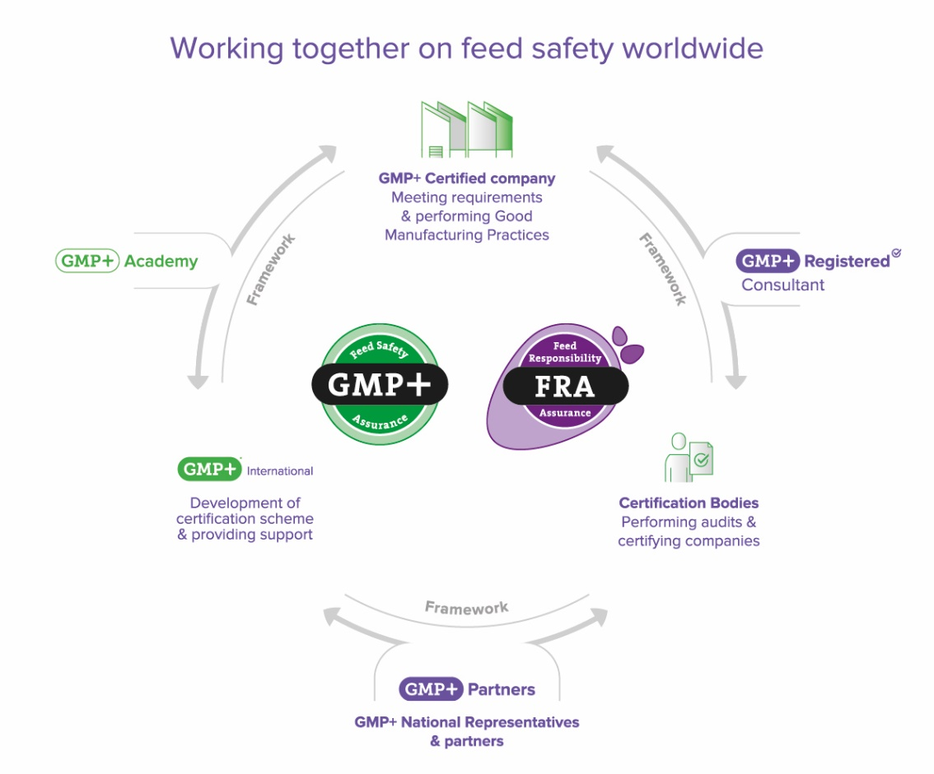

Slide 8
Adding value to former foodstuffs

Slide 9
Former foodstuffs to be used in feed

Slide 10

Understanding feed safety (by GMP+ certified companies)
Feed/food safety culture
Safe and suitable as feed material
Comply with legislation
Comply with needs from interested parties (e.g. suppliers)
Traceability system
Incident management
Hazard analysis based on HACCP principles
Sampling and monitoring
Purchase requirements

Slide 11
What food companies can do
FOOd/feed safety culture:
fEED companies are part of the fOOd chain
Clear and transparent communication: why product is no longer suitable for human consumption
Include former foodstuffs in your HACCP plan
Welcome your customer to perform a supplier audit
Cooperate in making agreement on roles and responsibilities

